Slide 1
REVIEW-1 MINIPROJECT TITLE: AUTO COMPONENTS MANUFACTURING UNIT
COURSE:MINI PROJECT USING PYTHON
COURSE CODE:20CSE59
USN:1NH18CS118
NAME: N KAVYA
SEM AND SEC:5 B
SUBMISSION DATE:22-10-2020

Slide 2
PROBLEM STATEMENT
The automobile industry comprises a wide range of companies and organizations involved in the design, development, manufacturing, marketing, and selling of motor vehicles.
This project focuses on Manufacturing of auto components.
The supply of auto components for the automobile plays a vital role.
The manufacturing of auto components involves a manufacturing unit,which in turn is responsible for sub components production,employees,quantity demand and raw materials maintainence.
Hierarchical division of workers based on status.
The auto components must be well showcased with all the details to make buyer easy to choose.
Buyers are automobile manufacturers.They require auto components in bulk.The demand must be calculated and productions target to be set.
The sales and income must be kept recorded.

Slide 3
BASIC DESIGN
A GUI application(using tkinter) on which creates platform for the project.
Programming language: Python
Relational Database: MySQL
Connecting mysql with Pycharm(Python IDE) using python-sql-connector.
Manufacturing head:
He manages the entire manufacturing unit.
He keeps account of product,buyer,manufacturing department ,raw input suppliers and workers.
Maintains sales and income of the unit.
DEPARTMENT:
Involves sub departments which has production of sub components.
Assembler is a department which assembles subproducts to get the final auto component.
Department will have many workers under them.

Slide 4
COMPOSITIONAL PRODUCTS:
Involves sub components and the raw inputs.
The availability and stock already available caluculation.
Department will keep track of compositional products.
PRODUCT:
This is the final product for the market.
The details and prices are available.
The products can be ordered to the cart with quantity.
CART:
Products selected will added to cart
Change in quantity or removal of product can be made by buyer
Total cost will be calculated.
On proceeding to payment and on successful payment,bill with order id will generated.

Slide 5
WORKER:
Salary is calculated based on number of working days and minimum amount each month
STOCK MANAGER:
Supervises Shift managers.Sets target for the department for production.
Will give leave approval for shift managers.
SHIFT MANAGER:
For each sub department there will be two shift managers.The shift is fixed for shift manager.
Supervises Employees.Sets target for the shiftwise employee for production.
Supervises Shift managers.Sets target for the department for production.
EMPLOYEE :
Employees work shiftwise(changes weekly).
RETIRED WORKER:
Information regarding provident fund is maintained.
PRODUCT ENGINEERS:
Work in assembly department
Directly supervised by Manufacturing Head.

Slide 6
CAREER PORTFOLIO:
Every worker submits his career portfolio
It includes personal information,education and experiences.
Career portfolio is linked with Worker id.
BUYER:
They must register .
They can login with the username and password.
If forgotten password , the buyer can reset using password hint.
The buyer can select the product and add to cart. Before proceeding to payment ,can make changes in cart.

Slide 7
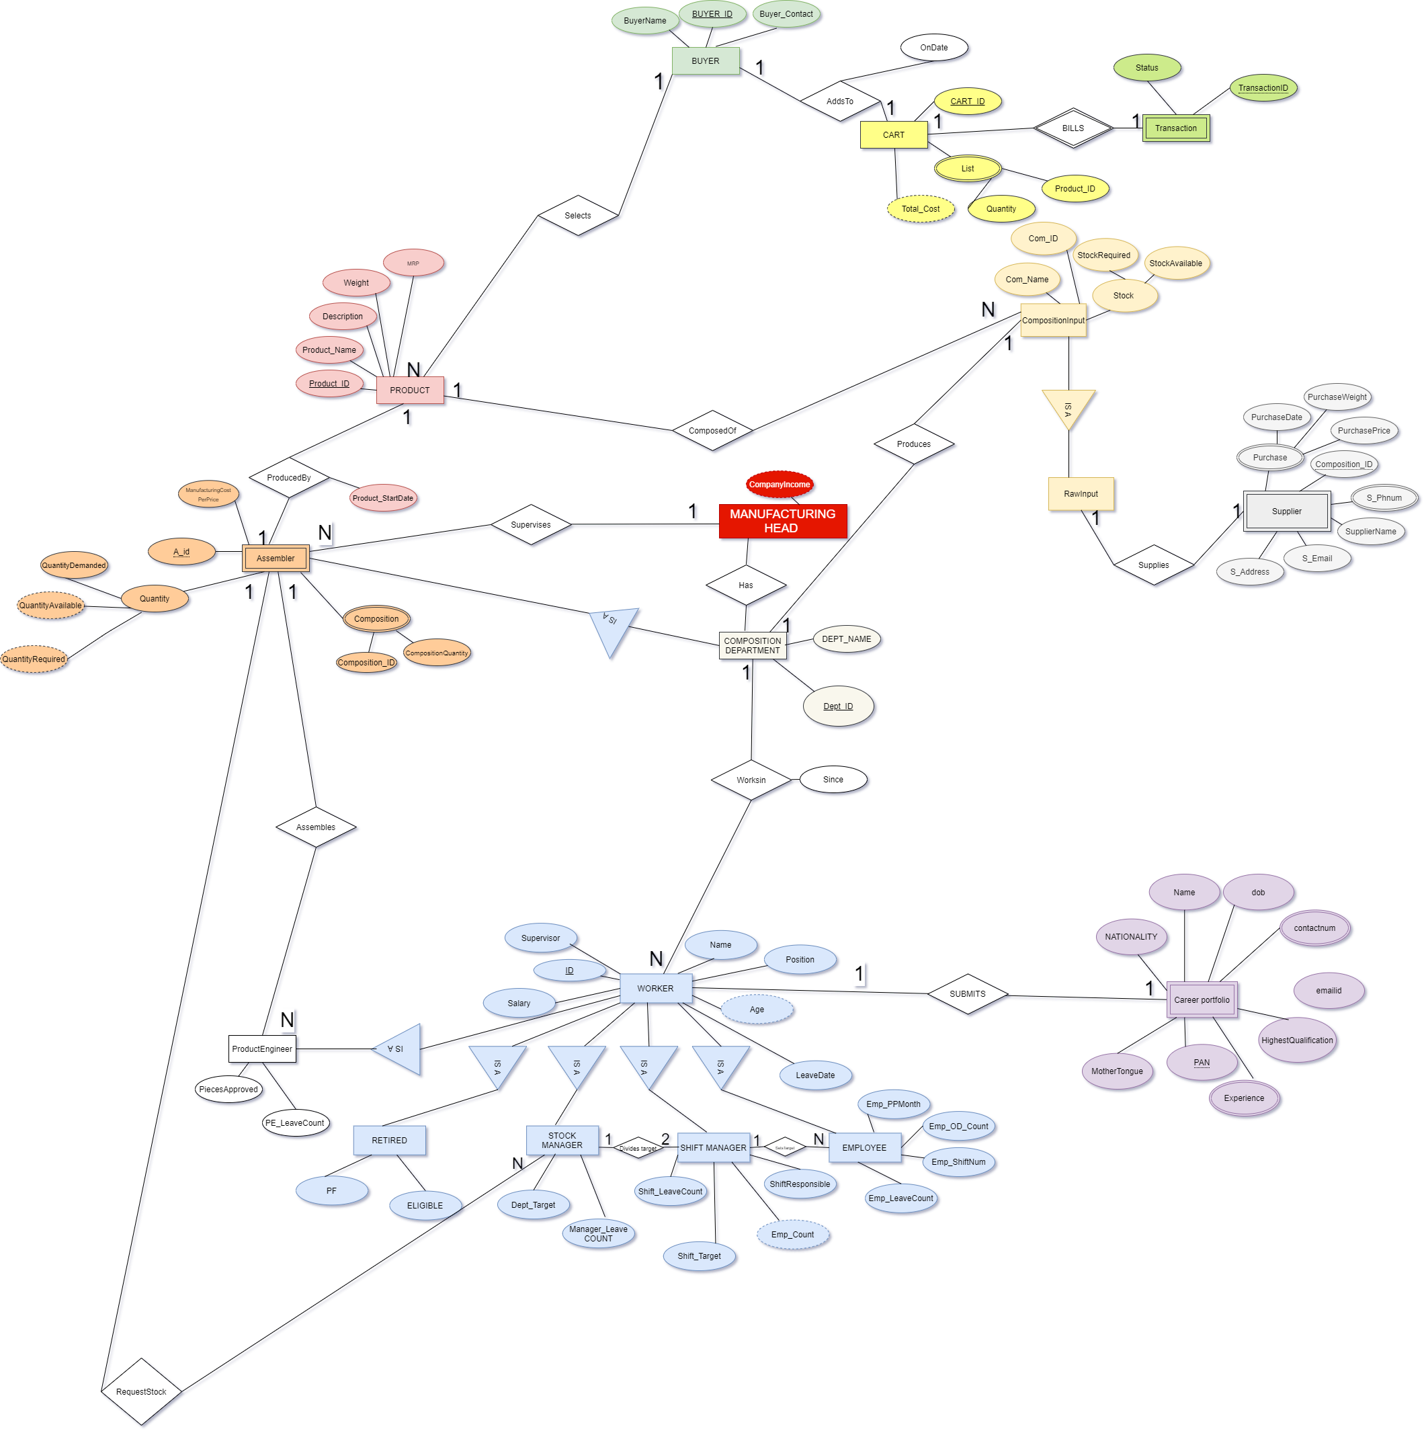
ENTITY RELATIONSHIP MODEL.

Slide 8
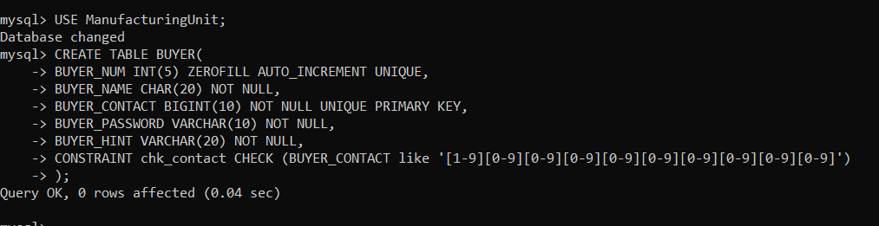
OUTPUT
1)CREATING DATABASE AND BUYER TABLE
2)PYTHON-MySQL Connector

Slide 9
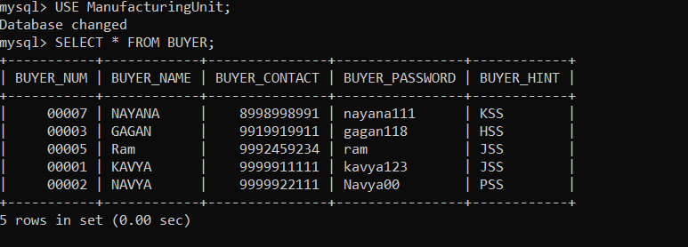
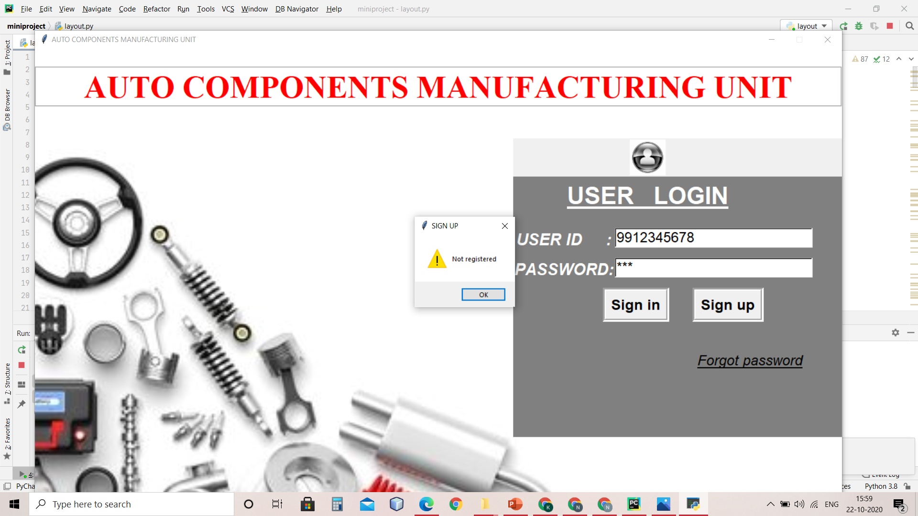
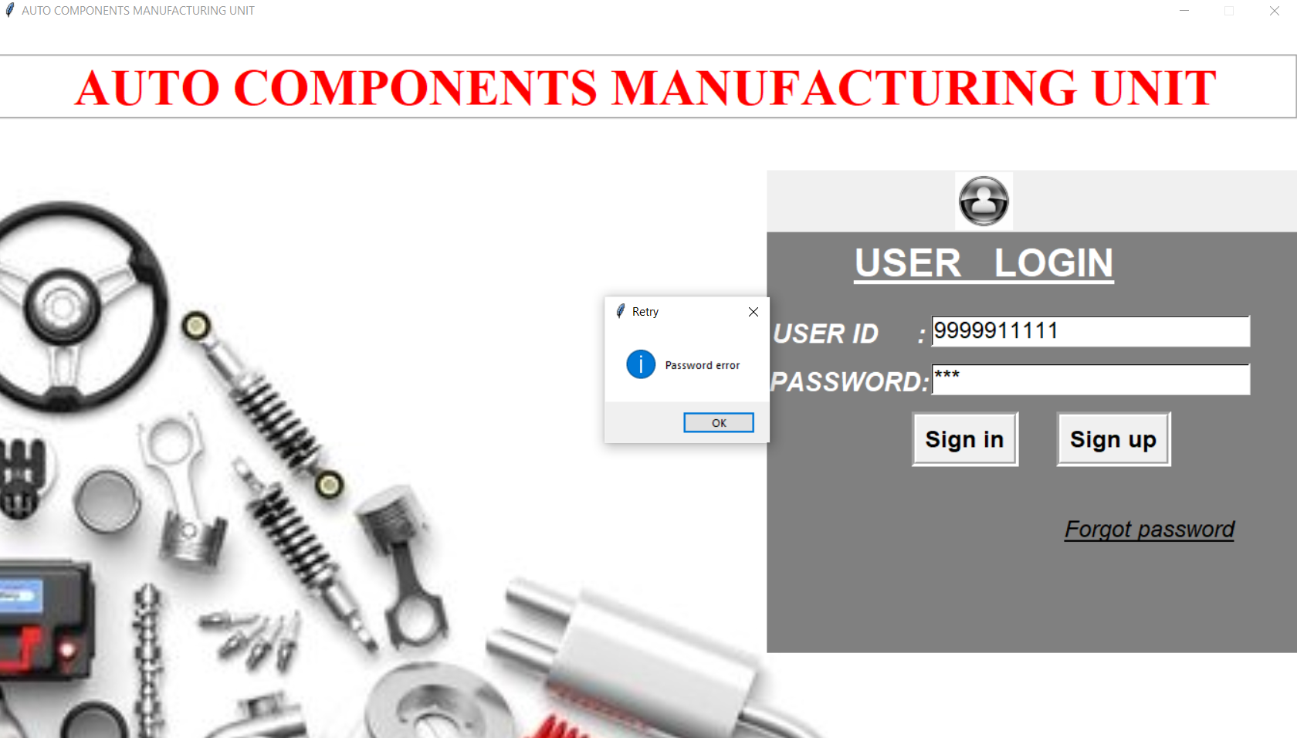
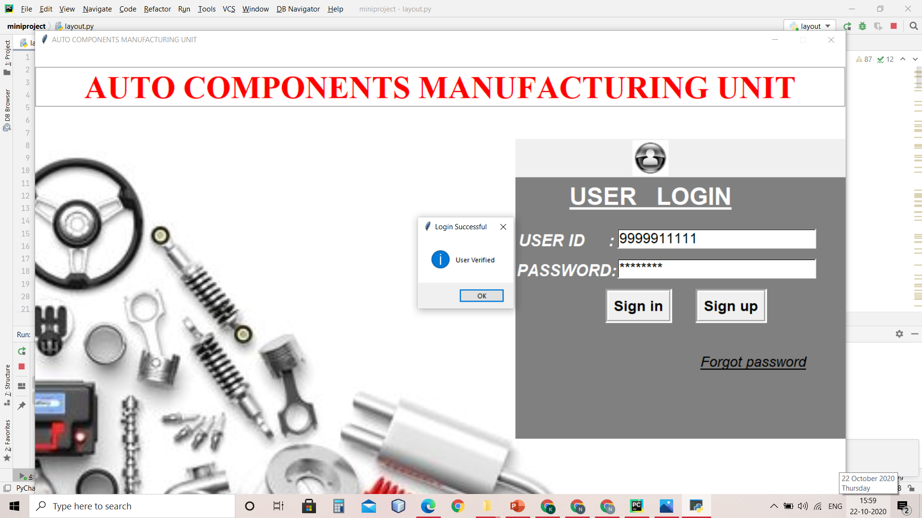
3)BUYER LOGIN

Slide 10
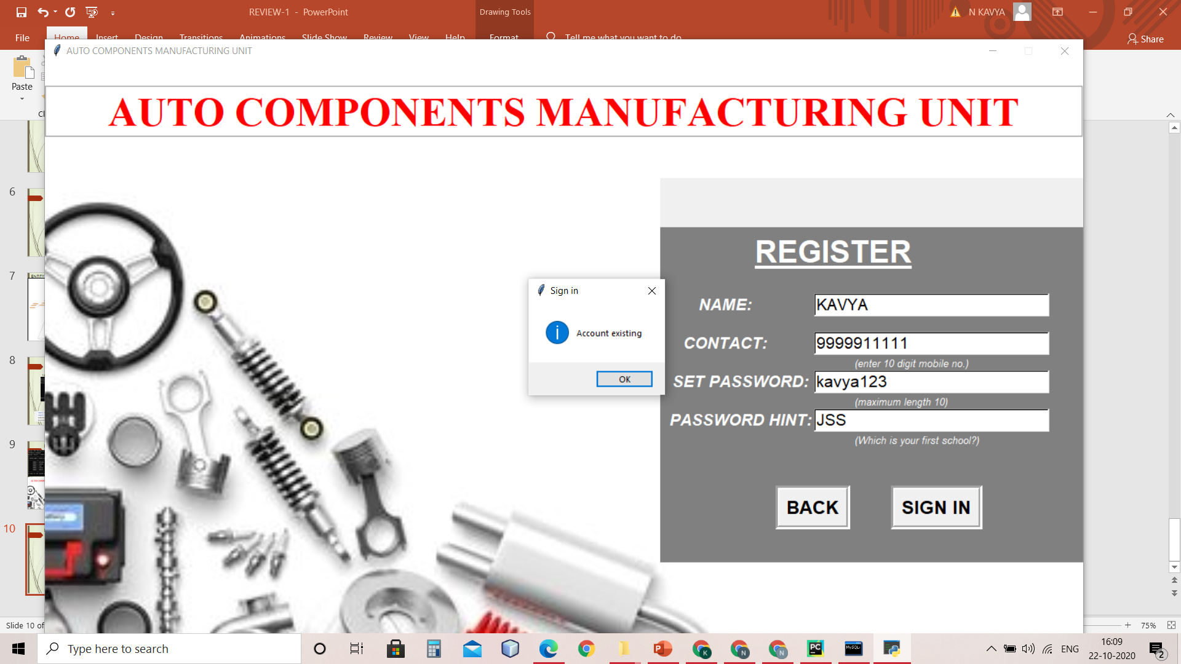
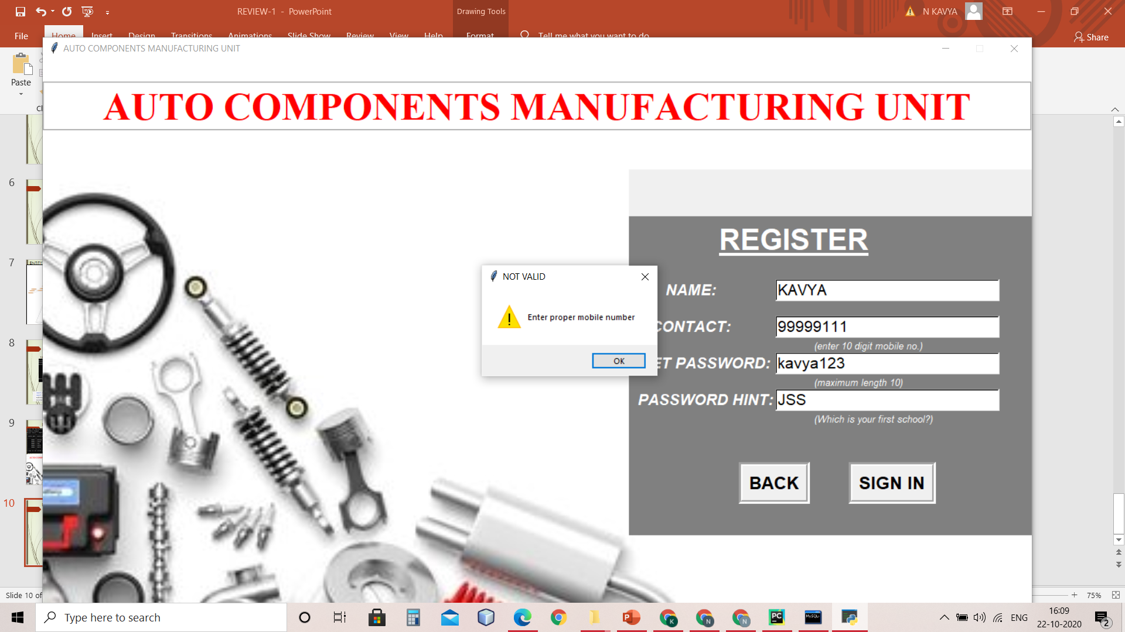
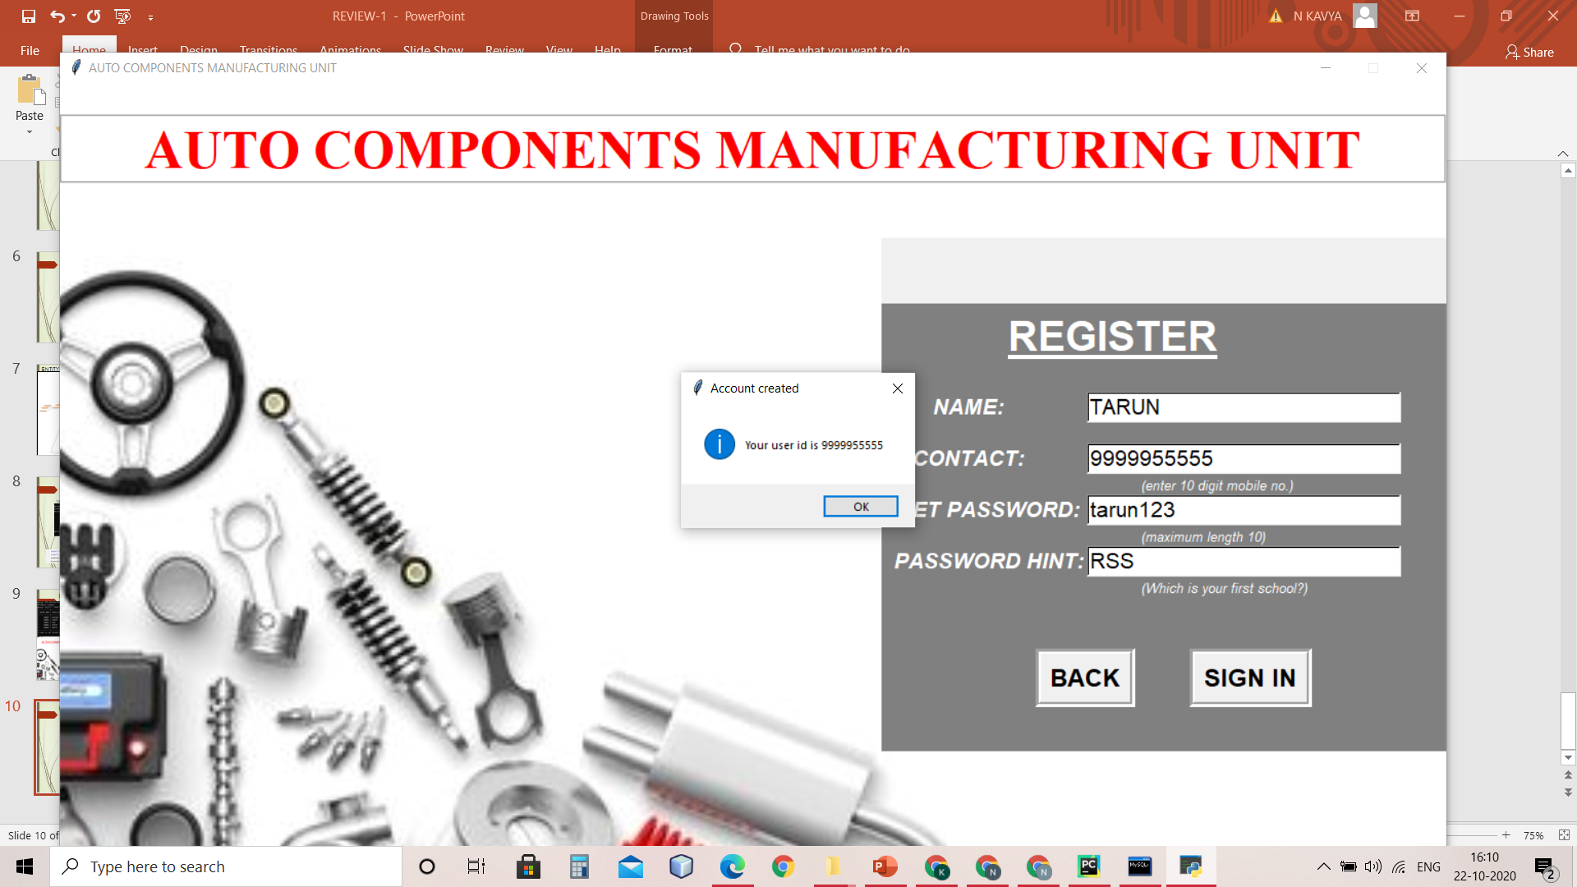

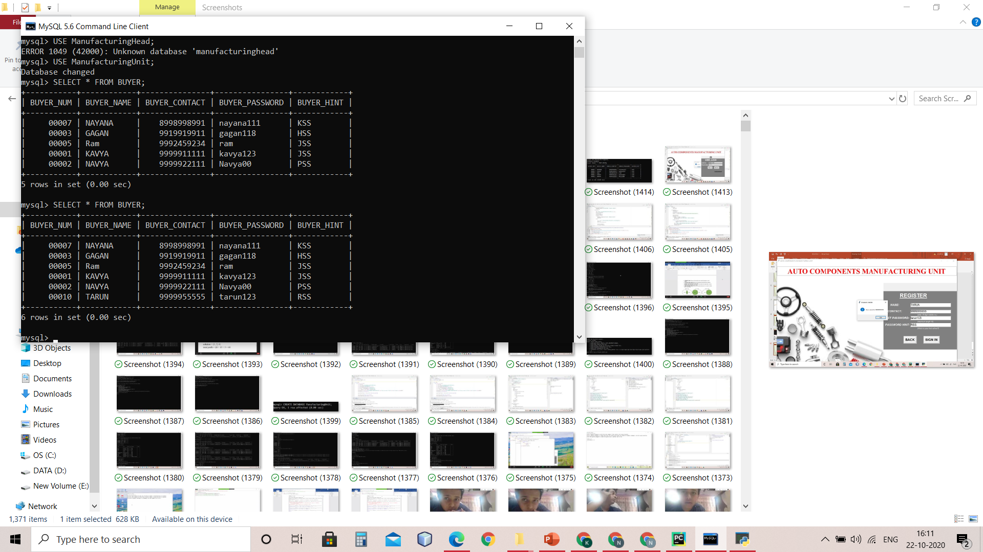
4)BUYER REGISTER

Slide 11
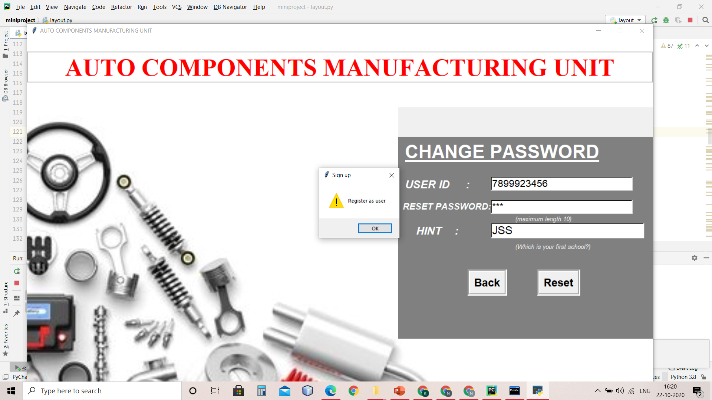
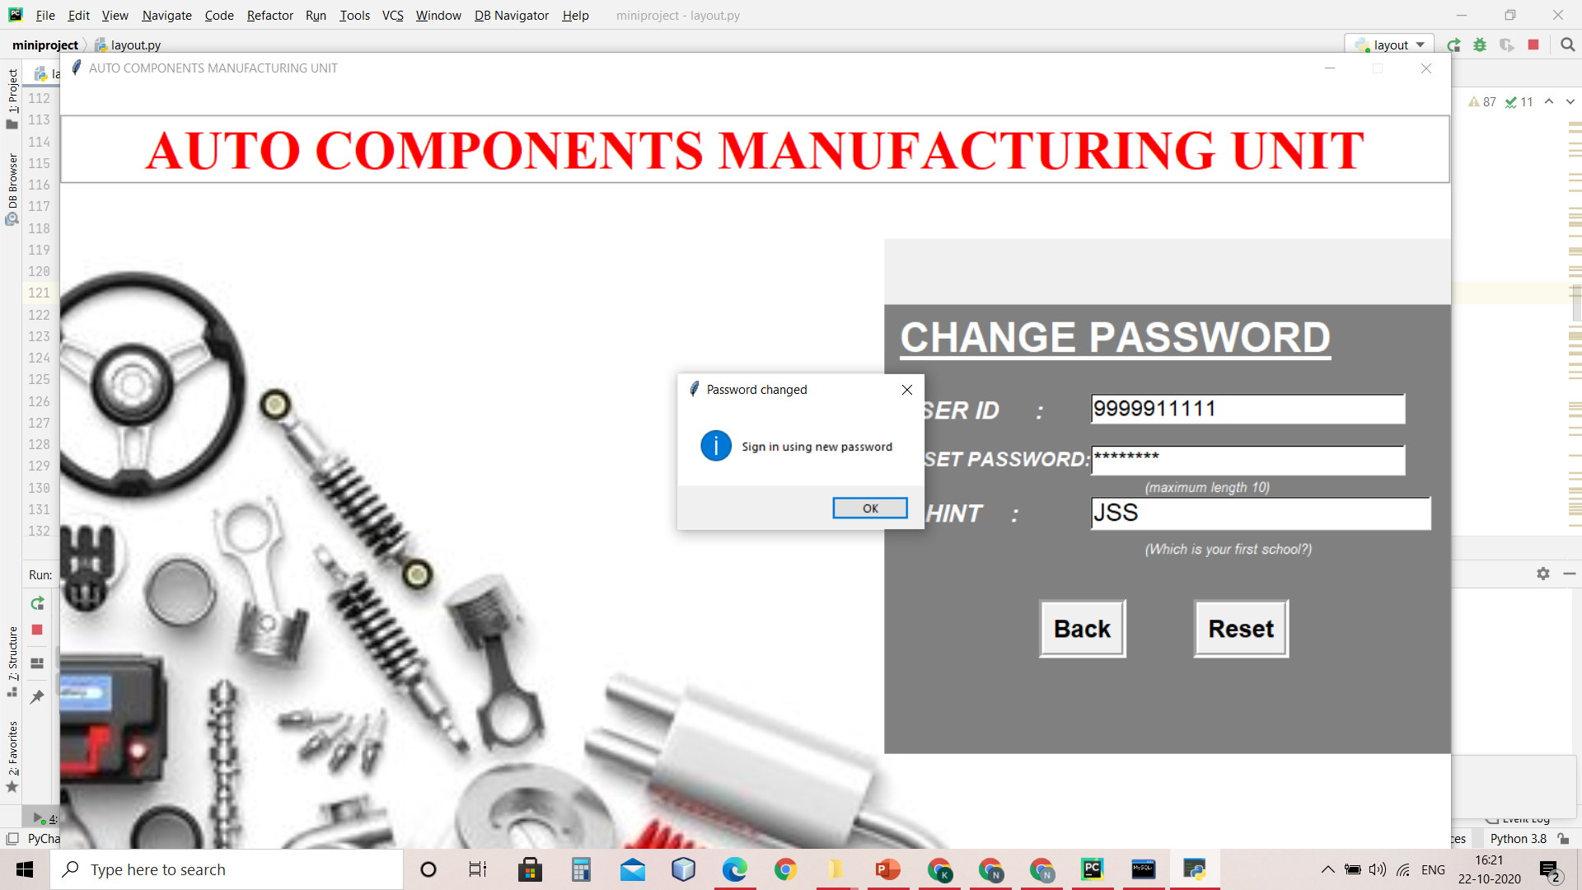
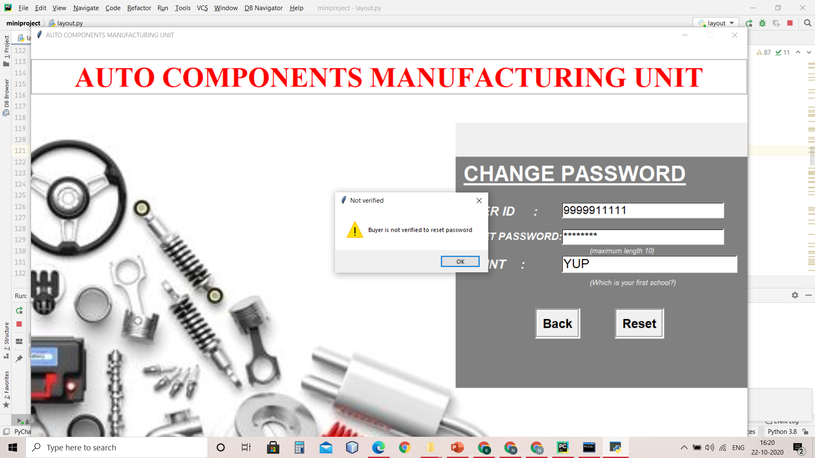
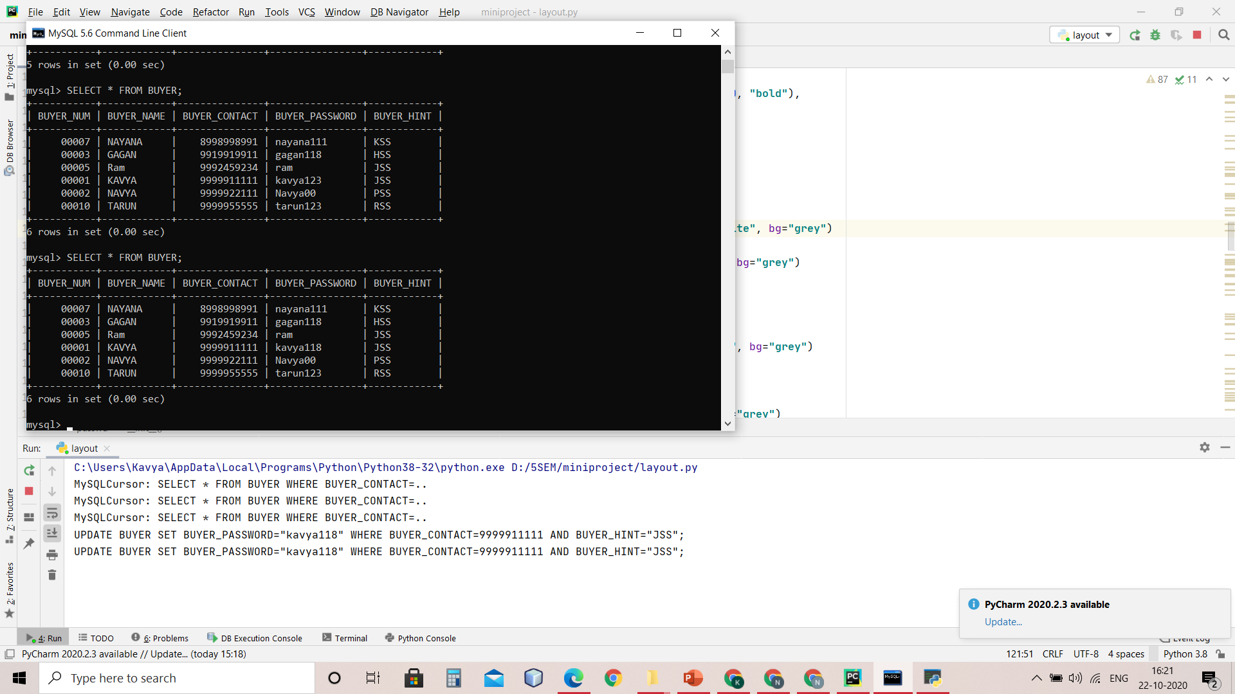
4)BUYER CHANGE PASSWORD

Slide 12
THANK YOU

